Slide 1







1
TEAM MEMBERS
1.SOHAM KAMBLE
2.ABHIJAY PANSARI
3.TUSHAR KUMAR
4.SAWON MITRA
2
FOOD FOR THOUGHT CHALLENGE
4
TEAM NAME: STRATEGEATS
3

Slide 2
















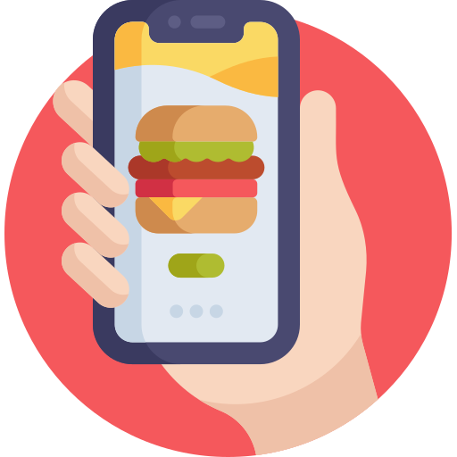

Problem Statement (for BIT MESRA)
Benchmarks & “Proof It Works” + learnings
Guesstimate (BIT MESRA model))
Grubhub Campus Integrated campus payments + on-ground outlets
Swiggy Learnings:
Partner with BIT canteens; accept ID wallet payments
14 Hostels,
Curfew Time 10 PM
After-Hours Access Gap
Post-curfew deliveries drop; hostels face safety and timing restrictions — students can’t order when they need it most.
4000 Total Students
₹ 8.28 L Weekly GMV
1800 Active Users (45%)
Mess Monotony & Lack of Choice
Snackpass
Social feed + ambassador programs + referrals = habit loop
Swiggy Learnings:
Activate Swiggy Streaks, Network Tree, DineOut Match
2 Orders per week × ₹ 230 AOV
Mess food is repetitive and campus cafés close early — limited options for variety or nutrition.
Delivery
Dine-out
Users: 1,800 active students (45 %) Avg. Orders / Week: 2 Avg. Order Value: ₹ 230 Take Rate: 20 % Weekly GMV: ₹ 8.28 L Monthly Revenue to Swiggy: ≈ ₹ 7.1 L
Users: ~600 students (15%) Avg. Group Size: 4 Avg. Frequency: 1 outing / 3 weeks Avg. Bill: ₹ 1,400/table Take Rate: 7 % Swiggy Revenue: ≈ ₹ 0.2 L / month
5. Health & Wellness – Purpose-Driven Loyalty​
Social Dining & Discovery Gap
Tapingo
Pre-order + pickup windows; strong peak-hour efficiency
Swiggy Learnings:
Launch Hostel Drop Windows & exam-hour menus
Dining out is a group activity but coordination, discovery, and split payments are cumbersome.
​
Boost App
Pre-order to cut lines, keep spend on-campus
Swiggy Learnings:
Add on-campus kiosk menus & scheduled pickups
Total Monthly Revenue : 7.3 Lakhs Per Month
Annual Potential (from one campus): 73L-88 Lakhs
Budget Sensitivity
Dining out is a group activity but coordination, discovery, and split payments are cumbersome.
45% Adoption + 3x repeat orders in peak weeks
Scalable Model: across 200+ Indian campuses = 160 crores+ opportunity

Slide 3
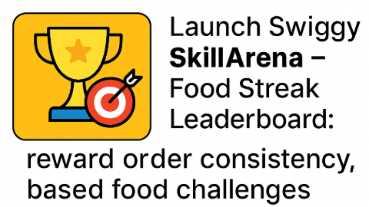
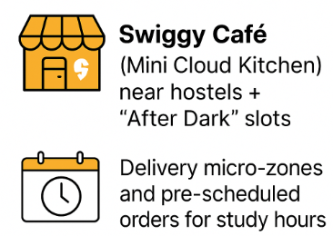

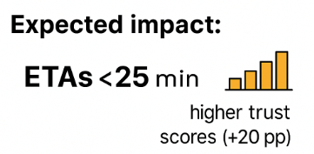
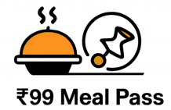
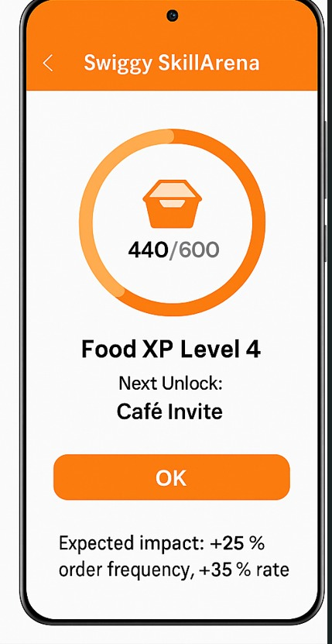
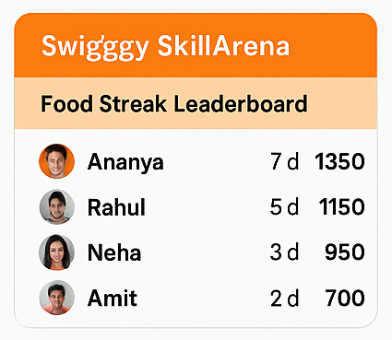

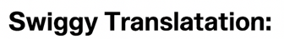

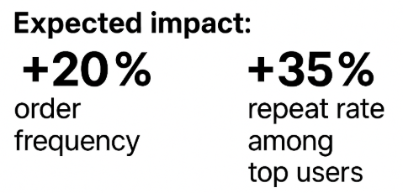
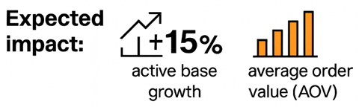
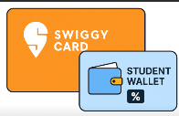
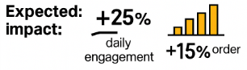

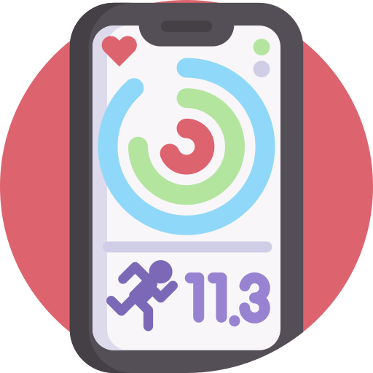
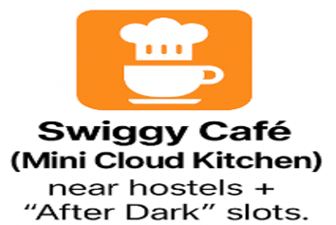
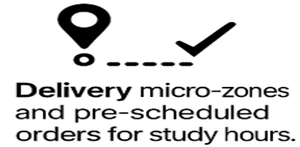

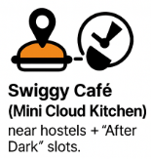






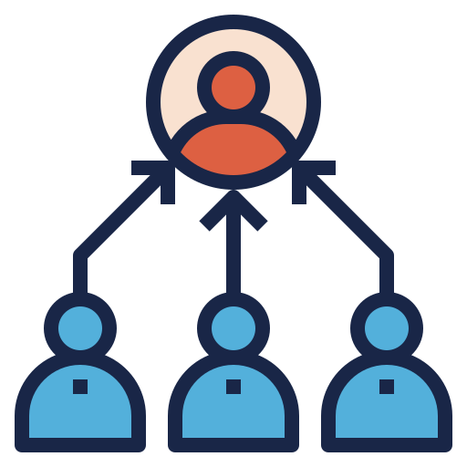
1. Gaming Industry – Habit Loops & Gamification
2. Fintech – Micro-Subscriptions & Smart Wallets
3. Mobility & Logistics – Micro-Hubs & Reliability
Benchmark: 🎮 Duolingo / Strava/ SkillArena Duolingo’s streaks boosted daily engagement 4×; Strava’s challenges raised retention by 35 %; Kaggle/Codeforces-style leaderboards drove peer competitiveness, with SkillArena seeing >50 % weekly active users.
Micro-subscription tier plans
40 % higher LTV and 25 % lower churn.
Exam weeks, Gym sessions to auto-suggest meals. Predictive ordering (“Usual at 8 PM”)
5. Health & Wellness – Purpose-Driven Loyalty​
5. Health & Wellness – Purpose-Driven Loyalty
4. EdTech & Productivity –Personalization via Data
6. Social Media and Community Platforms
Benchmark: 🛵 Uber Reserve / Zepto Dark Stores / Dunzo Minute
Micro-hubs cut delivery ETAs by 35 %; Uber’s scheduled rides improved reliability metrics by 28 %.
Benchmark: 💪 Fitbit / Headspace / Nike Run Club
Linking food + fitness increased app adherence 2.4×; gamified streaks = +60 % weekly returners.
Student Referral
Campus Ambassador
Secondary Referral
Swiggy Translation:
Protein Integration & Fit-Meals Badge system; tie-ups with campus gyms.
Create Food & Fitness Challenges with nutrition dashboards.
Expected impact : builds trust + positive brand perception among health-minded students.
60% increase
​
Join challenge
Tag friends
Gamification increases organic reach
Expected Impact:
ETA < 25 min + higher trust scores
Share proof
Rewards

Slide 4



Implementation Roadmap — Swiggy Campus Model
Execution Dashboard — KPIs, Benchmarks & Next Steps
🧠
Stage 2 — Community Build-Out (3–5 months)
Stage 1 — Pilot Launch (0–2 months)
Goal: Establish foundation on campus. Key Actions:
Launch Swiggy Campus Wallet linked to
student IDs.
Partner with mess & 10 nearby cafés.
Form Campus Ops Cell (students + Swiggy).
Stages
KPIs
Goal: Drive loyalty & social engagement. Key Actions:
Launch Swiggy SkillArena – Food Streak Leaderboard & XP Levels. → Reward consistent users & create “Food XP” gamification.
Launch Ambassador Program & referral tree.
Introduce Feast Fridays + Club tie-ups (Coke, Maggi).
1
500+ wallets, <25 min ETA, NPS +20
2
2,000+ users, 20% retention lift, ₹2.5L GMV
<25 min ETAs, +12% AOV, +25% reliability
3
🚀
25K students onboarded, ₹12L+ GMV, breakeven <9 months
Stage 3 — Tech & Ops Scale-Up (6–9 months)
4
Goal: Boost reliability & personalization. Key Actions:
Build Swiggy Café micro-hubs near hostels.
Enable AI-based Food Intelligence + scheduled orders.
Integrate SkillArena metrics → reward reliability streaks (on-time orders, high NPS cafés).
Stage 4 — Regional Expansion (9–12 months)
📈
Benchmark | Action Needed
Stage 1 | Grubhub integrated with university meal-plan APIs & local cafés
Stage 2 | Grubhub loyalty + SkillArena habit loop (Duolingo/Strava model)
Stage 3 | Grubhub micro-hubs + Uber reliability models.
Stage 4 | Grubhub multi-campus ecosystem
Goal: Expand model to nearby colleges. Key Actions:
Roll out to 10+ East-India colleges.
Add Essentials vertical + brand monetization.
Cross-campus SkillArena leaderboard for intercollege gamification. .

Slide 5




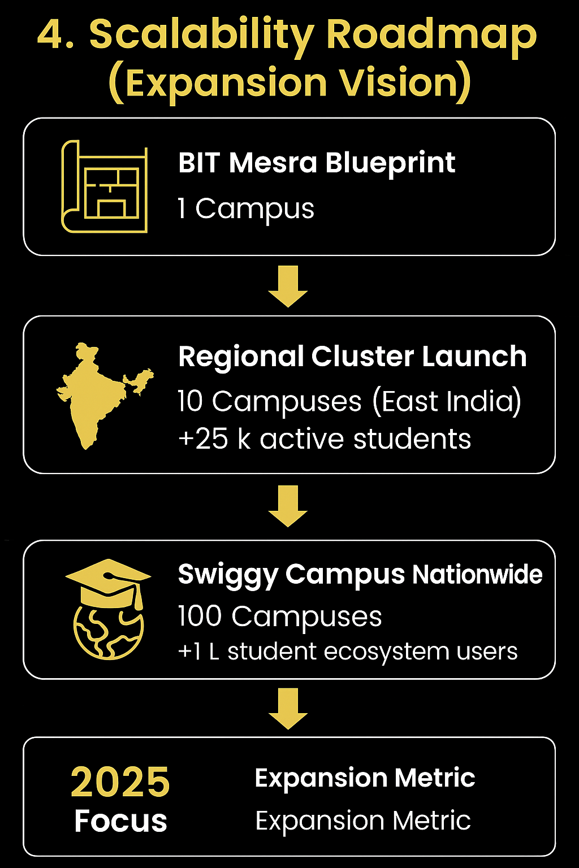
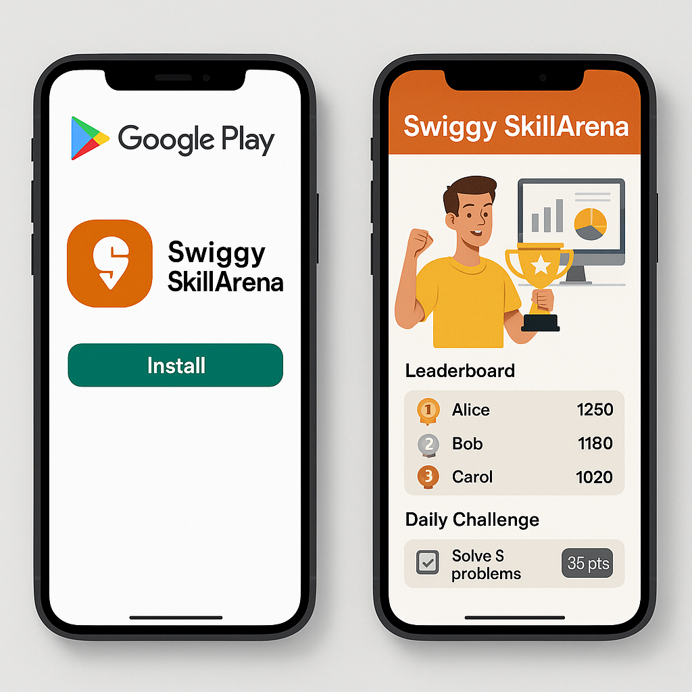
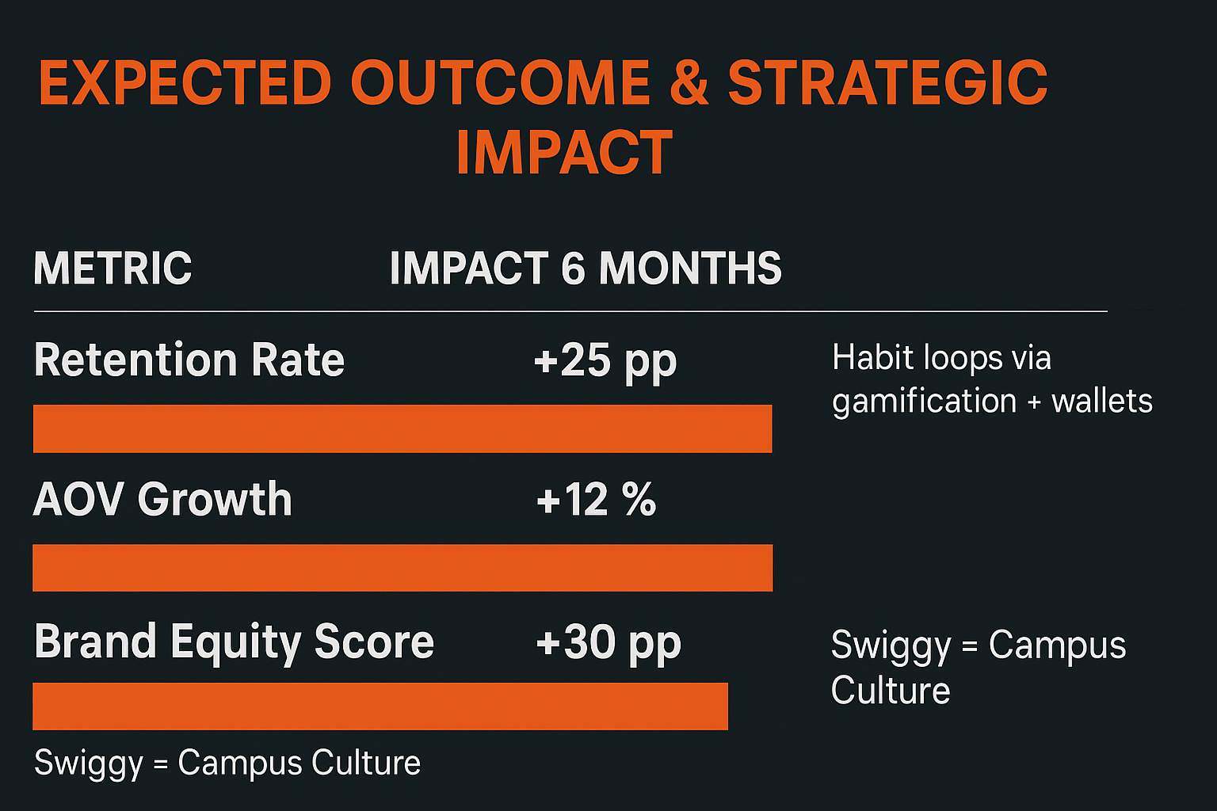
New Frontiers of Growth (Beyond Food)
Campus Ecosystem Partnerships
Concept: Integrate mess, cafés, stationary stores, and hostels into one Swiggy Campus Wallet. Insight: Similar to WeChat Campus Mini Apps in China, where 70% of payments now occur in student ecosystems
Quick Commerce & Essentials
Concept: Add groceries, exam supplies, and “midnight snack kits.” Insight: Zepto’s 10-minute model drove +40% new user base from student micro-zones.
Internships & Brand Partnerships
Concept: Swiggy Ambassador Program → tie-ups with brands like Coke, Maggi, and college fests. Insight: Red Bull Campus Ambassadors operate in 200+ colleges and achieved 3× brand recall.
Skill & Community Integrations
Concept: Host hackathons (“Swiggy Data Feast”) and link rewards to meal passes. Insight: Google Dev Clubs reported +60% higher student retention via reward-linked events.
Data Source
Swiggy internal + EY India F&B Study
KPMG Consumer Survey
Zepto campus pilot
Red Bull / Campus Feasts
Student Lifestyle Index
Industry | Learning | Swiggy Application
🧾 EdTech (Chegg / Coursera) | Smart recommendations improve habit retention. | Adaptive “Swiggy Food Plans” that personalize meals.
🎧 Music Apps (Spotify) | “Daily Mix” personalization keeps users returning. | “Your Daily Crave” playlist for favorite foods.
💬 Communication (Discord / Slack) | Micro-communities boost belonging and engagement. | Create “Swiggy Clubs” — food + friend communities.
💰 Fintech (CashApp) | P2P split payments increase group transactions. | Enable “Split Bill” via Swiggy Wallet for friends.

